Slide 1

siamese neural networks for one-shot image recognition
JuHyeong Kim

Slide 2
Siamese neural networks
Siamese neural networks are Metric-based learning.
Calculate the distance for each label and measure the same label closely and the other label far away.
https://www.kakaobrain.com/blog/106

Slide 3
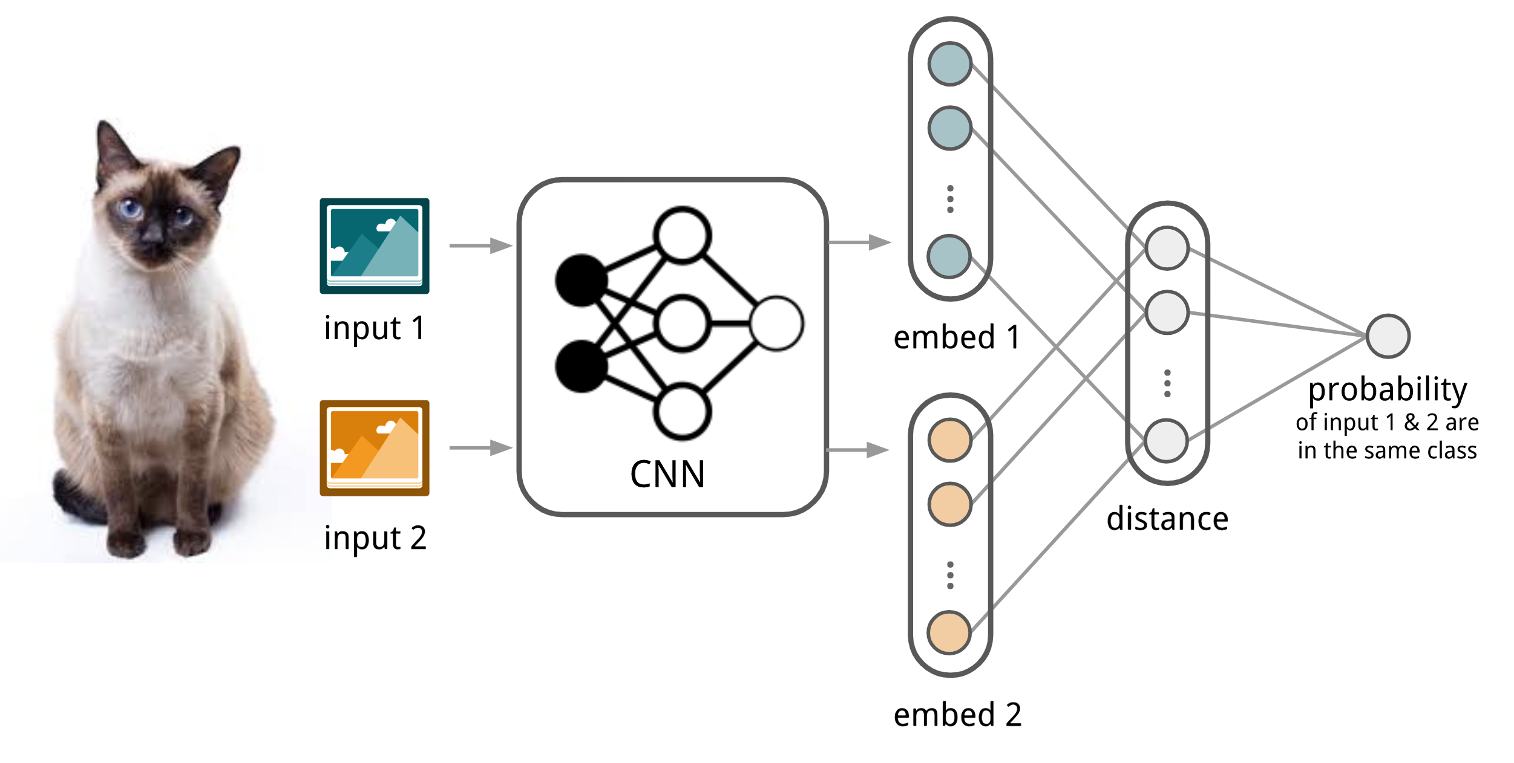
Siamese neural networks
Siamese Neural network for one-shot image recognition(ICML deep learning workshop, 2015)
Measure the distance similarity by comparing the two inputs.
embed1 and embed2 represent features for input 1 and input2.
The last probability represents the similarity between the two inputs.

Slide 4
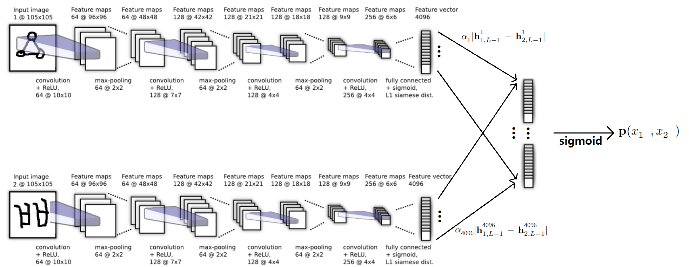
Siamese neural networks structure
The figure below is a specific structure.
L1 distance
vector

Slide 5
Siamese neural networks structure
This part is input data.
L1 distance
vector

Slide 6
Siamese neural networks structure
This part is a CNN structure that extracts characteristics.
* Same structure, same weight.
→ The same characteristics are extracted.
L1 distance
vector
same structure and same weight
=

Slide 7
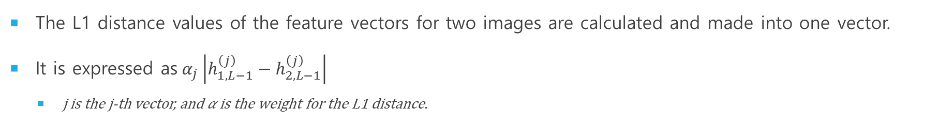
Siamese neural networks structure
The L1 distance values ​​of the feature vectors for two images are calculated and made into one vector.
It is expressed as$α_{j}\left|h_{1,L−1}^{\left(j\right)}−h_{2,L−1}^{\left(j\right)}\right|$
j is the j-th vector, and 𝛼 is the weight for the L1 distance.
L1 distance
vector

Slide 8
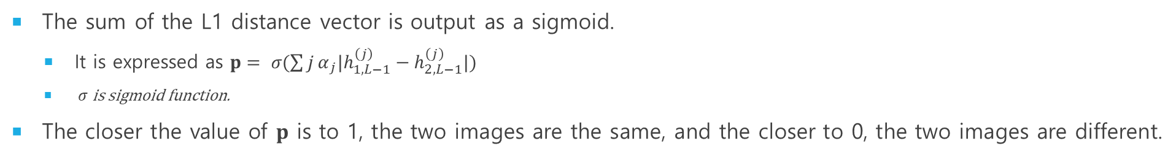
Siamese neural networks structure
The sum of the L1 distance vector is output as a sigmoid.
It is expressed as ${p= σ(\sum{j}α}_{j}|h_{1,L−1}^{\left(j\right)}−h_{2,L−1}^{\left(j\right)}|)$
$σ$ is sigmoid function.
The closer the value of 𝐩 is to 1, the two images are the same, and the closer to 0, the two images are different.
L1 distance
vector

Slide 9
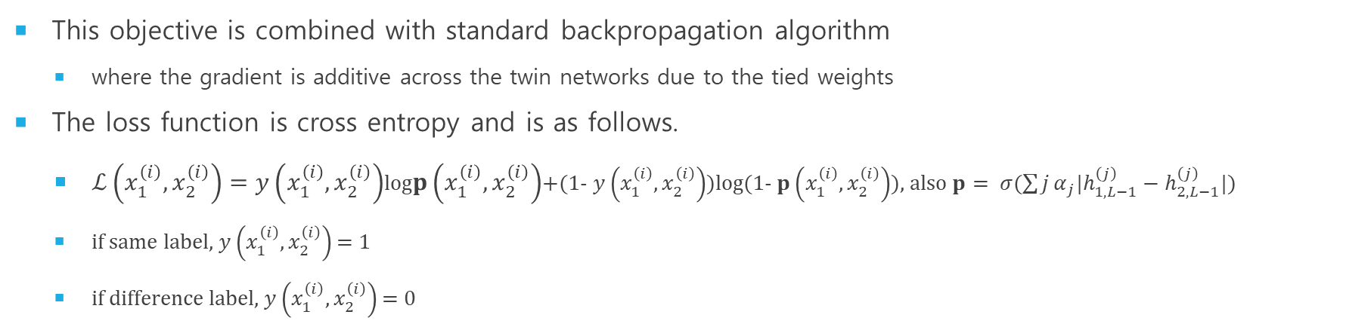
Learning
This objective is combined with standard backpropagation algorithm
where the gradient is additive across the twin networks due to the tied weights
The loss function is cross entropy and is as follows.
$ℒ\left(x_{1}^{\left(i\right)},x_{2}^{\left(i\right)}\right)=y\left(x_{1}^{\left(i\right)},x_{2}^{\left(i\right)}\right)$log$p\left(x_{1}^{\left(i\right)},x_{2}^{\left(i\right)}\right)$+(1- $y\left(x_{1}^{\left(i\right)},x_{2}^{\left(i\right)}\right))$log(1- $p\left(x_{1}^{\left(i\right)},x_{2}^{\left(i\right)}\right)$), also ${p= σ(\sum{j}α}_{j}|h_{1,L−1}^{\left(j\right)}−h_{2,L−1}^{\left(j\right)}|)$
if same label, $y\left(x_{1}^{\left(i\right)},x_{2}^{\left(i\right)}\right)$ = 1
if difference label, $y\left(x_{1}^{\left(i\right)},x_{2}^{\left(i\right)}\right)$ = 0

Slide 10
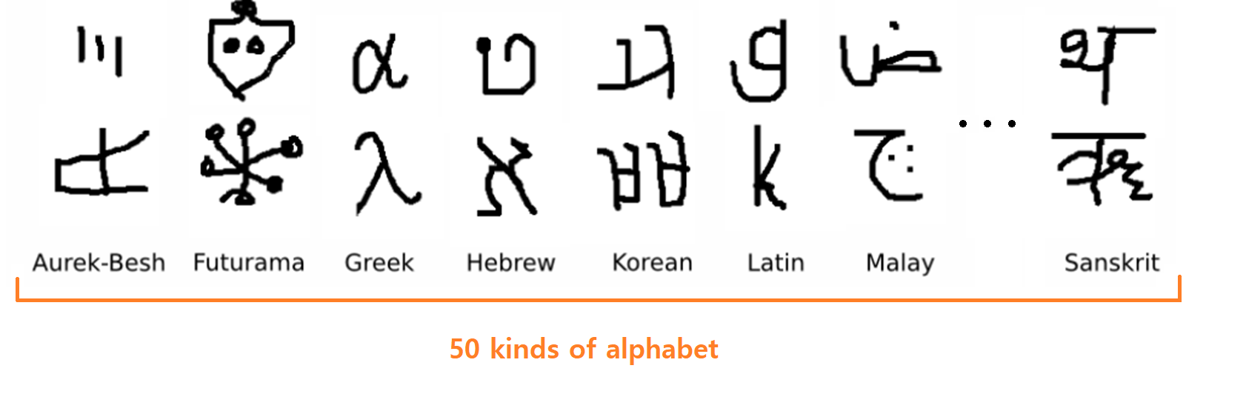

experiments
The dataset used The Omniglot Dataset.
There are 50 alphabets and there are 15-50 characters for each alphabet. The total number of characters is 1623.
It was written by handwriting by 20 people. → drawer ( Total 1623 * 20 characters )
There were two types of verification network and one-shot training/testing.
x
20
drawer
= 1623 characters

Slide 11
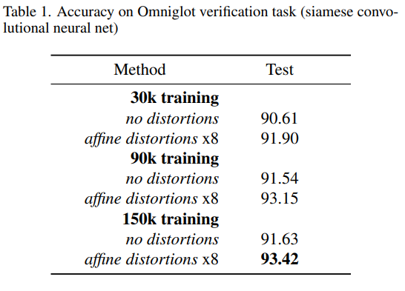
Verification network
We set aside sixty, twenty, twenty percent of the total data for training, validation, testing
Training set : 30 alphabets out of 50 and 12 drawers out of 20.
Validation set (evaluation set) : 10 alphabets out of 50 and 4 drawers out of 20.
Test set : 10 alphabets out of 50 and 4 drawers out of 20.
To train our verification network, we put together three different data set sizes with 30,000, 90,000, and 150,000 training examples by sampling random same and different pairs.
no distortions : 30k, 90k, 150k of data
8 transforms were used.
affine distortions x8: 270k, 810k, 1350k of data

Slide 12
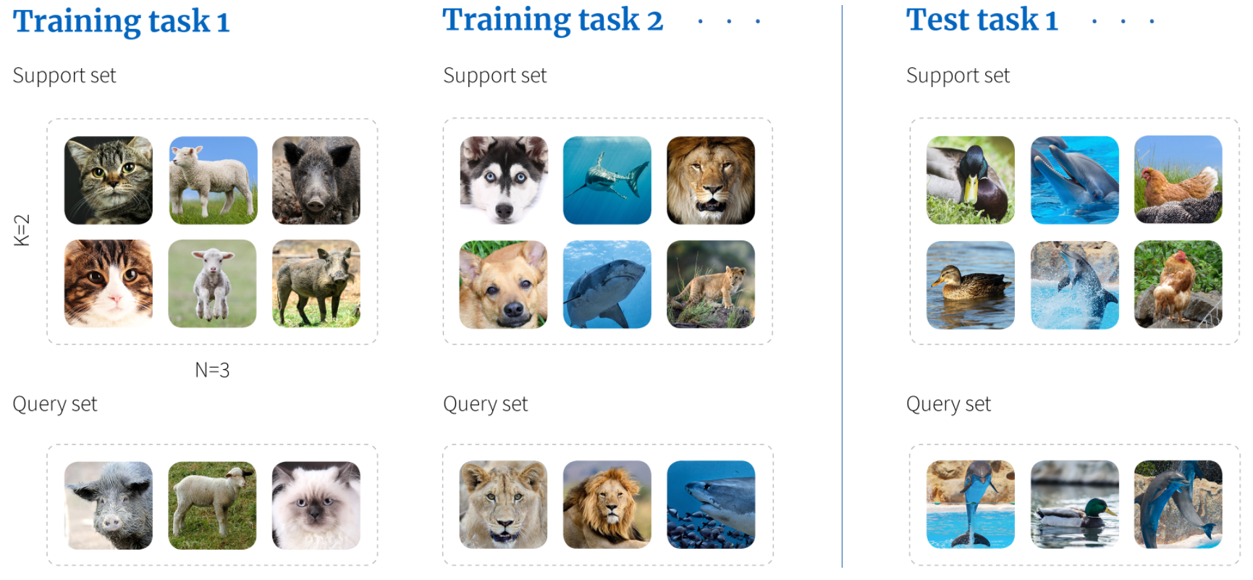
one-shot learning
N-way K-shot learning is to choose one of the support sets that has K for each N class.
Support Set is a dataset that supports training and testing.
Query Set is a dataset for training and testing.

Slide 13
DONE

Slide 14
one-shot learning dataset
In this paper, they do 20-way one-shot learning.
Like the Verification network, 60% of the total data is used as training data.
Training set : 30 alphabets out of 50
Validation set(evaluation set) : 10 alphabets out of 50
Test set : 10 alphabets out of 50

Slide 15
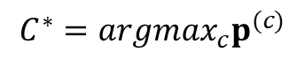
one-shot learning dataset
Validation and test is as follows:
Select 2 out of 20 drawers.
This is a method of selecting the most similar image by comparing the image created by the first drawer (Query) and the image set (Support set, 20-way) of the second drawer.
Repeat the above procedure twice for all alphabets.
That is, try 40 times per alphabet.
There are 10 evaluation alphabets and test alphabets → 400 trials and tests.
Query
$$C^{∗}={argmax}_{c}p^{(c)}$$
Support set(20-way)

Slide 16
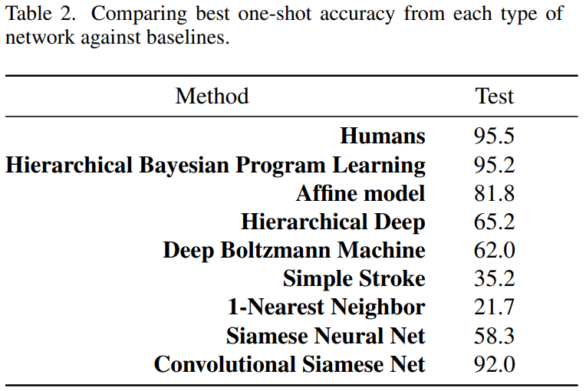
Experiments
3.5% less accurate than human measurements.
3.2% less accurate than Hierarchical Bayesian Program Learning.
“ While HBPL exhibits stronger results overall, our top-performing convolutional network did not include any extra prior knowledge about characters or strokes such as generative information about the drawing process. This is the primary advantage of our model.“
논문의 알고리즘

Slide 17
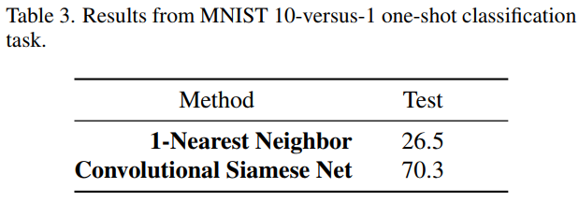
MNIST One-shot Trial
This is to check how much MNIST generalized models learned with Omniglot.
In the training set, no fine-tunning was performed and only the MNIST test set was used.

Slide 18
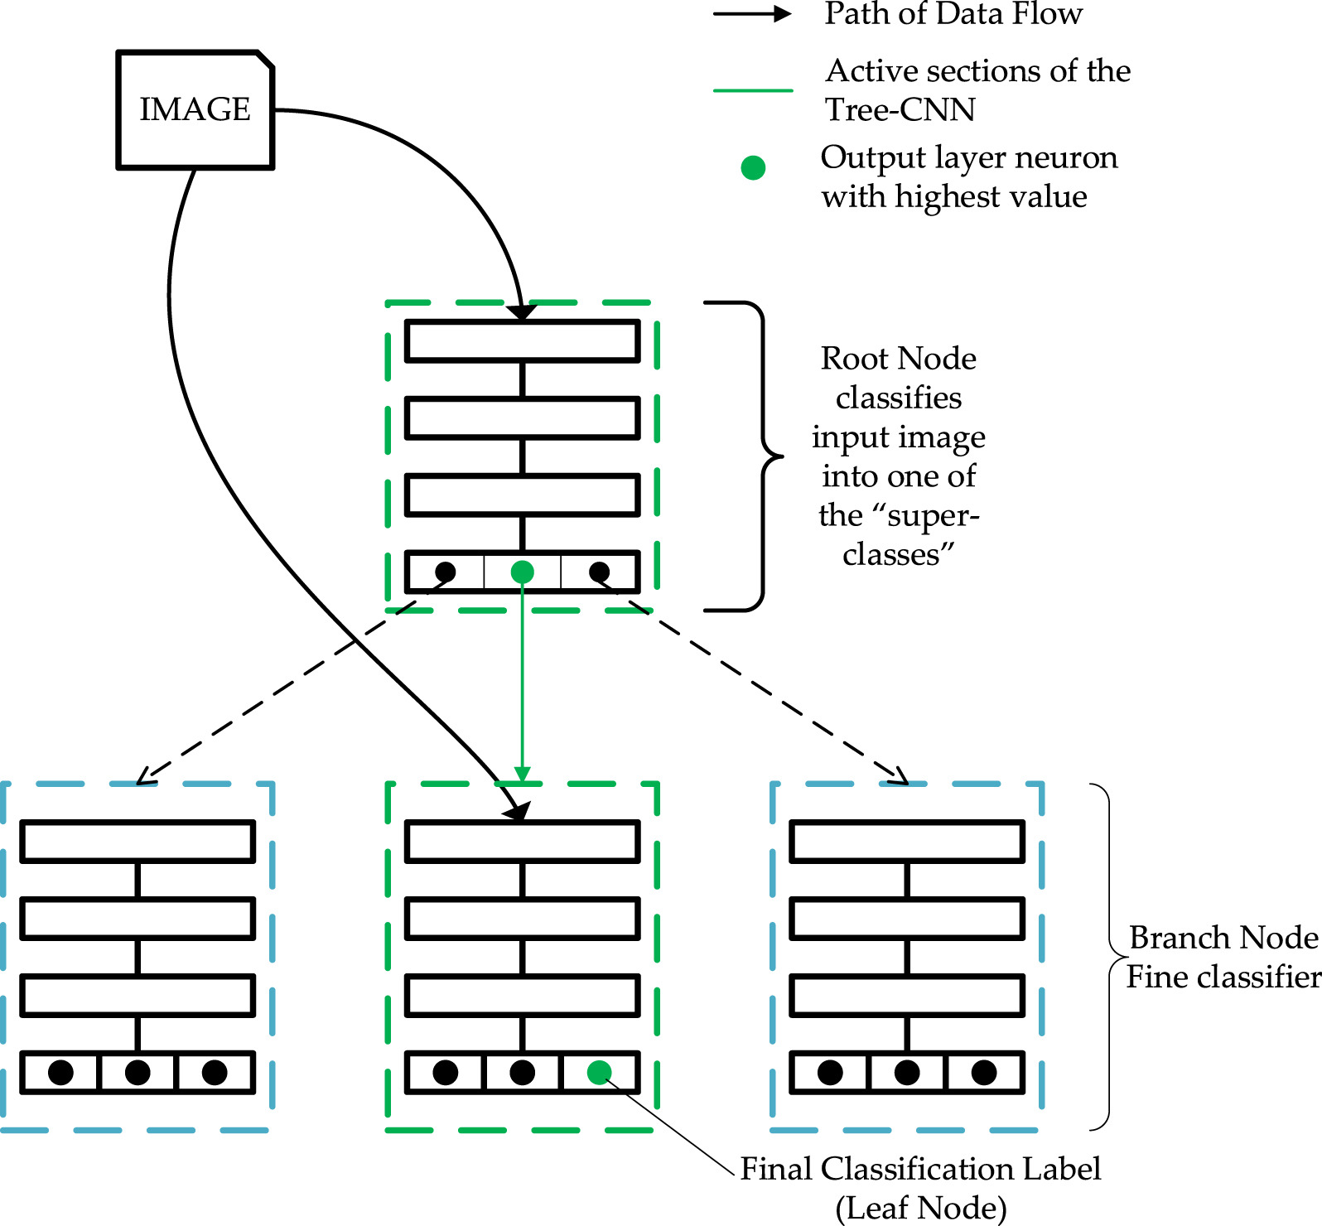
IDEA
위의 metric based few-shot learning과 Tree-CNN을 결합하면 더 나은 결과가 나올 것 같다.

Slide 19
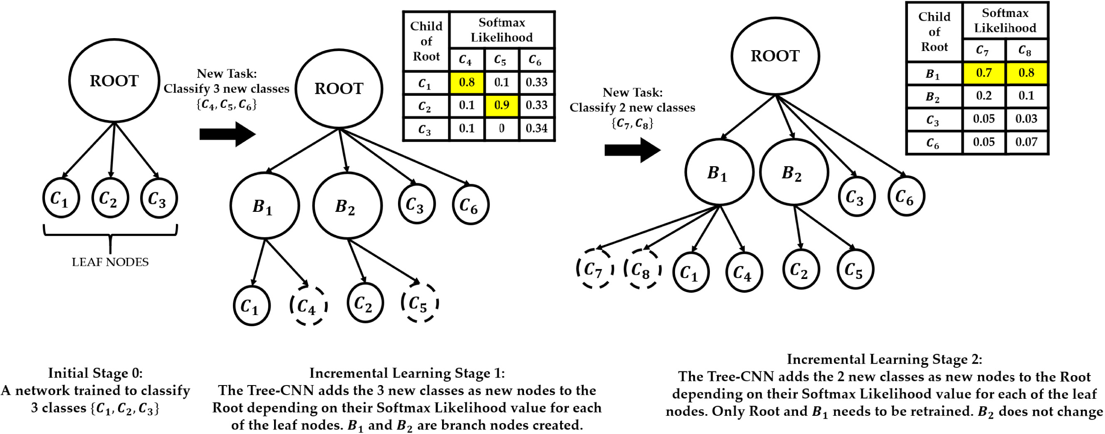
IDEA
위의 metric based few-shot learning과 Tree-CNN을 결합하면 더 나은 결과가 나올 것 같다.

Slide 20
IDEA
기존 Tree-CNN은 incremental learning과 데이터 분류에서 의미를 갖는다.
하지만 많은 데이터가 필요하며, 다음 branch node로 이동할 때 CNN dence layer의 단점을 고스란히 전수받는다.( under/overfitting, 많은 layer 필요 등등 )

Slide 21
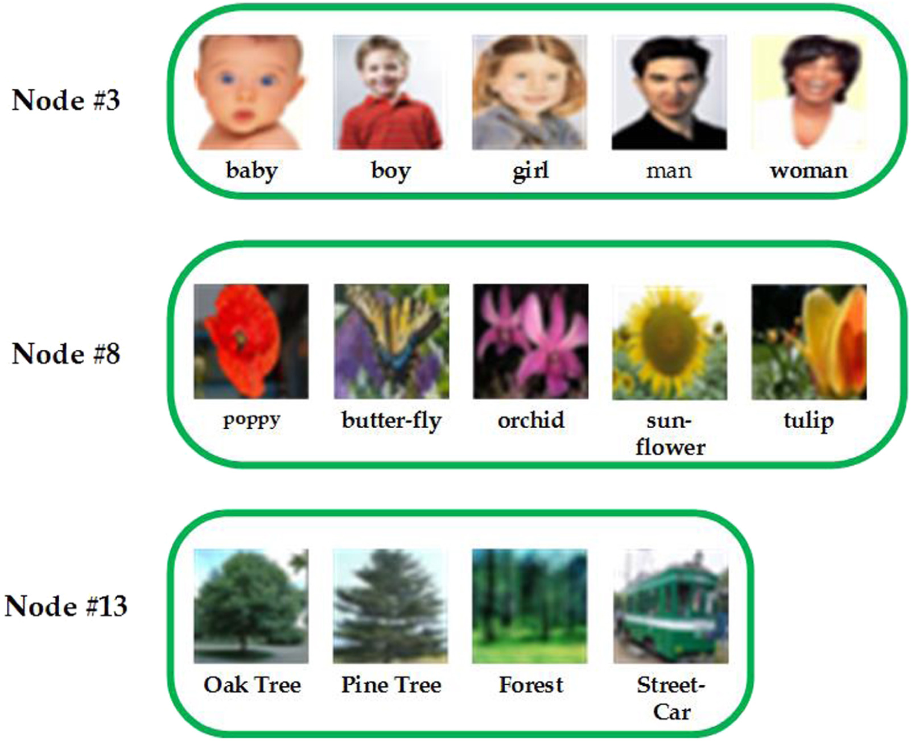
IDEA
위의 단점을 보완하여 metric based few-shot learning과 결합하면 적은 데이터로 학습이 되며, 다음 branch node로 이동할 때 데이터의 거리를 기준으로 다음 branch node로 이동하게 된다.
또한 branch node마다 서로 다른 metric based 알고리즘을 적용할 수 있다.
*추상적으로 Tree-CNN에서 다음 branch node로 이동할 때마다 이미 학습된 데이터들의 거리가 가까워지기 때문에 서로 다른 class들끼리 서로 거리를 조절하게 되면 성능이 개선될 것 같다.

